Slide 1
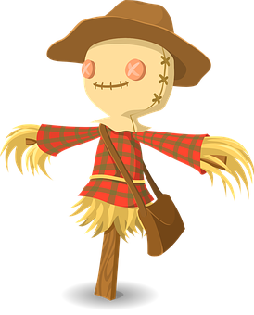
Healthy Harvest Made Accessible
Climate Change AI Hackathon 2019
ScareCrow.Ai

Slide 2
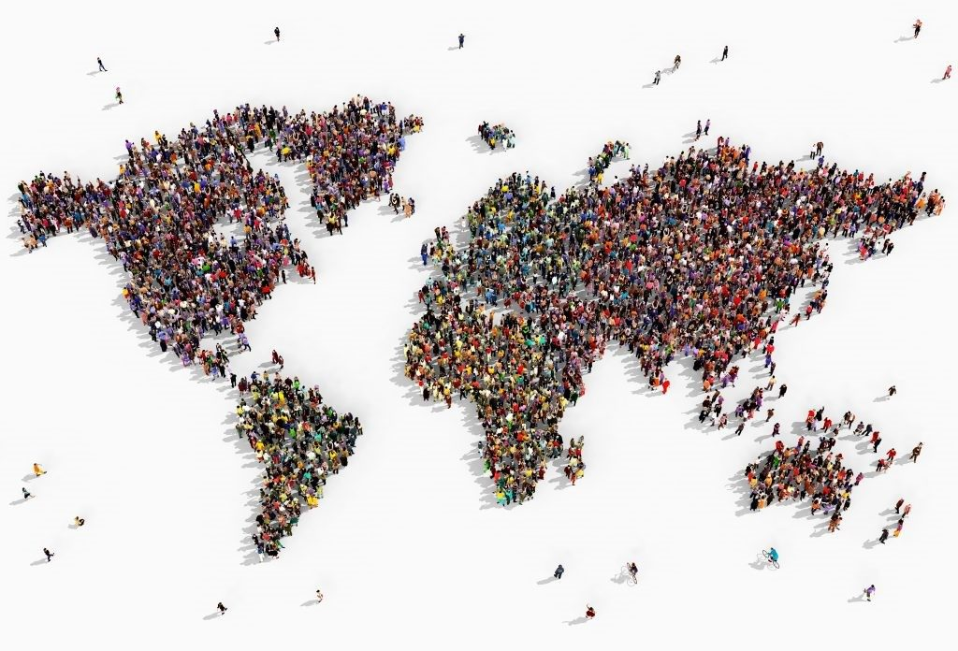
The Problematic
To feed 7 billion people
Threat for food security:
Climate change
Decline in pollinators
Plants diseases
etc.
Notes:
Because of climate change
Unpredictable variation in temperature, wind, sun, etc.
Seasons are unpredictable (especially in Quebec)
The human footprint has dramatically affected the pollinators populations
Plants diseases are increasing in frequency as well as in diversity
New plant diseases are discovered every year

Slide 3
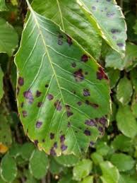
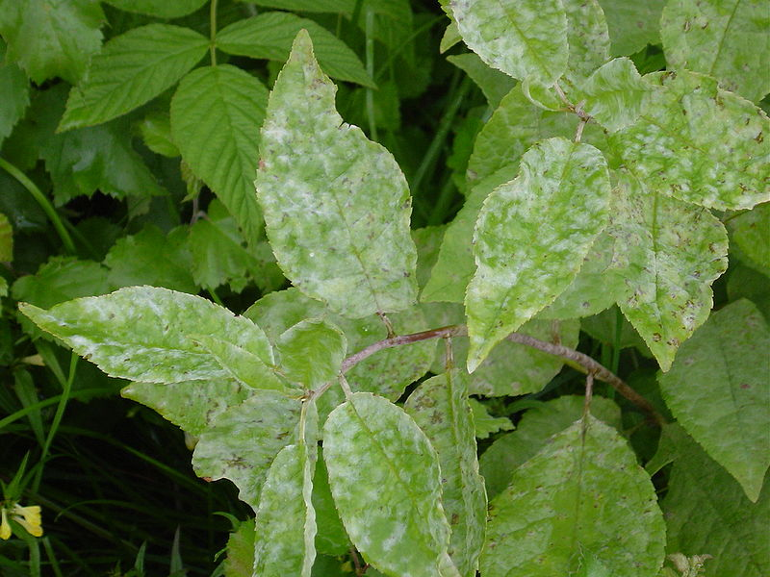
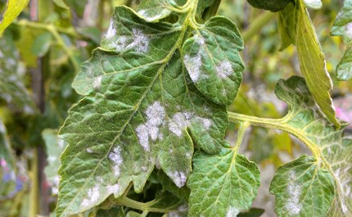
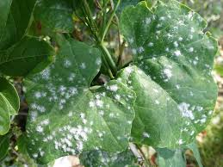
Plants Diseases Consequences
Contaminations & infestation of nearby plants
Yield loss→ Food insecurity
Malnutrition
Loss of money → Stress
Notes:
How this issue is currently address?

Slide 4
Current Solutions
Herbicides
Insecticides
Bactericides
Fertilizers (Organic & Inorganic)
Synthetic Chemicals
Notes:
Those chemicals are costly, it raise the price of our food and not all farmers can afford them

Slide 5
Current Solutions → Problematics
Costly
Enter food chains
Damage soil & groundwater supplies
Altering nearby & distance ecosystems
Pollute rivers, lakes & oceans
Damage fish supplies
Organisms evolve!!!
Notes:
Even if you can afford them…
Enter the food chains
Damage the soil
Polluting groundwater supplies
Altering ecosystems even on distance land
End up in rivers, lakes & oceans, which pollute & contribute to algea bloom
Starve water bodies of oxygen, which affect the health of our fish supplies
They evolve! Which is a vicious circles as the industries need to develope better chemicals to fight againts them
Thus, those methods are also costly and unhealthy for both humans & the environments

Slide 6
ScareCrow.AI
Healthy Harvest Made Accessible!

Slide 7
ScareCrow.AI
Our solution is:
Cost effective
Minimum knowledge required
Effortless
Preventive
Notes:
Our solution is:

Slide 8
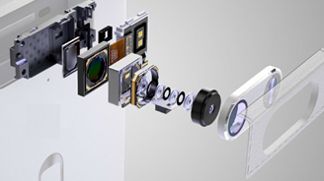



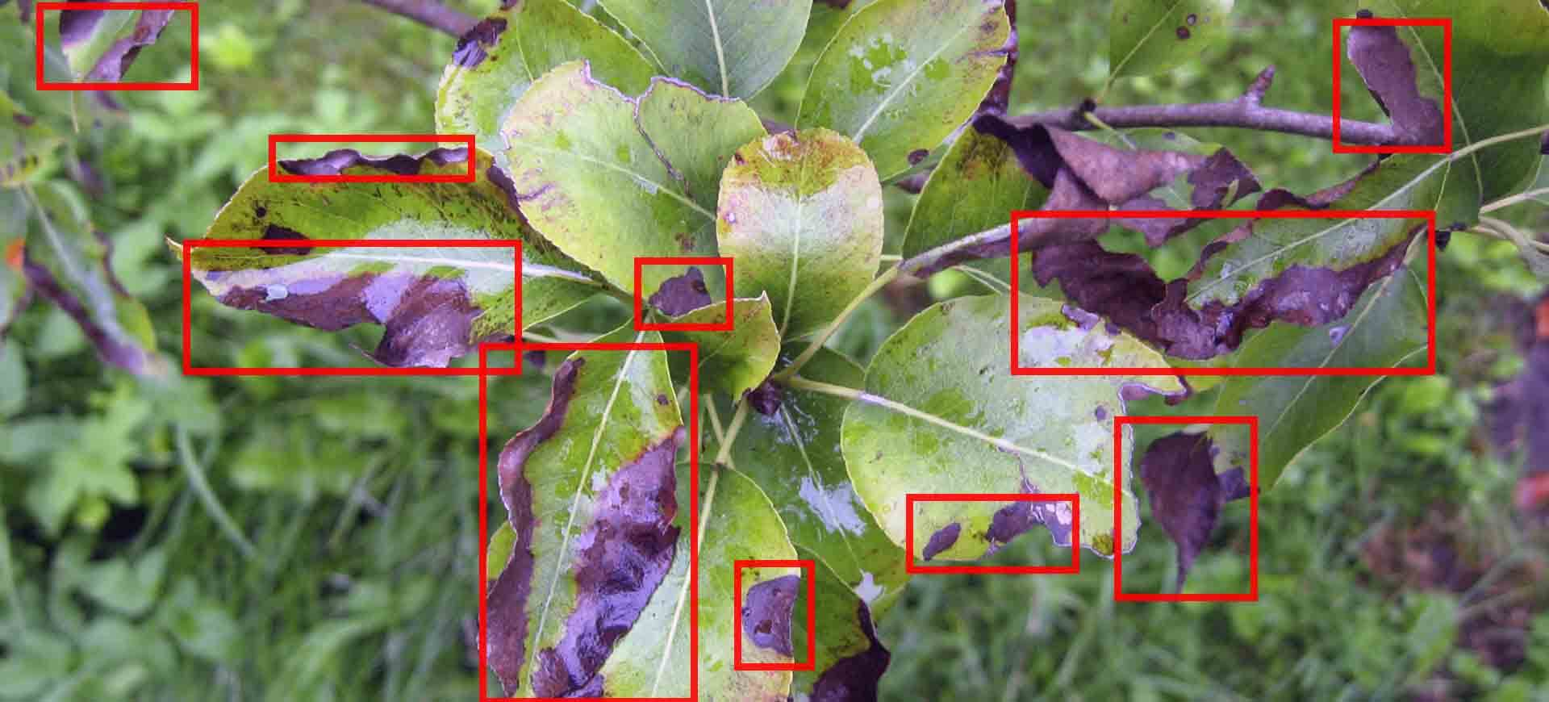
ScareCrow.AI
Notes:
With the widespread of smartphone usage: between 5 and 6 billion smartphones on the globe by 2020.
The advance HD camera on all smartphones
ScareCrow.AI combine the power of smartphone with the power of image recognition to automatically diagnose disease at early stage so that actions can be taken immediately

Slide 9
Methodology
14 different crops species
38 class labels
26 different diseases
Use deep learning to analyse 54k + images
Dataset distributions: Train: 88% ; Test: 12%

Slide 10
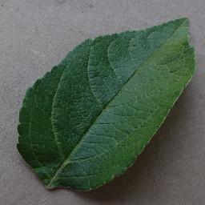
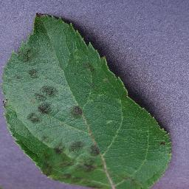
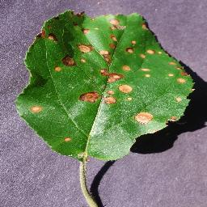
Methodology
Apple - Healthy
Apple – Apple Scab
Apple – Black Rot

Slide 11
AI
Train the model
fastai.vision:

Slide 12
GUI

Slide 13
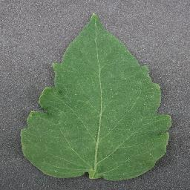
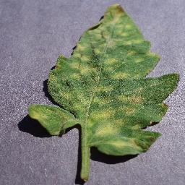
Applications
Tomato - Healthy
Tomato – Leaf Mold

Slide 14
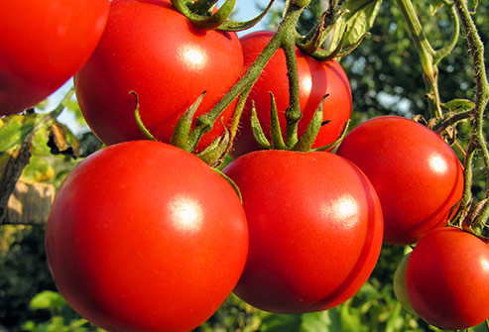
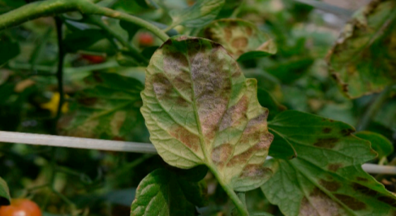
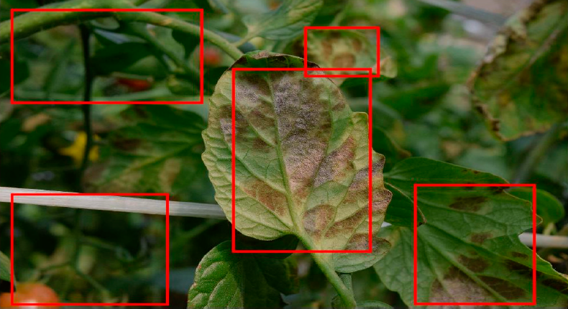
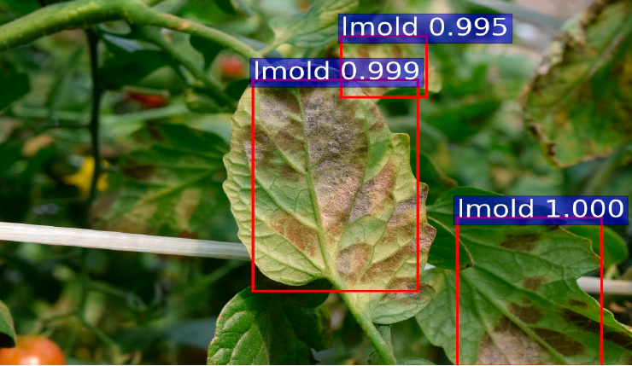
Applications -Tomato Leaf Mold
Input Image
Annotated Image
Predicted Result
Notes:
Further development is needed to train the AI to recognize the leaf & disease with a more real-life picture of the plants (not just the leaf itself).

Slide 15
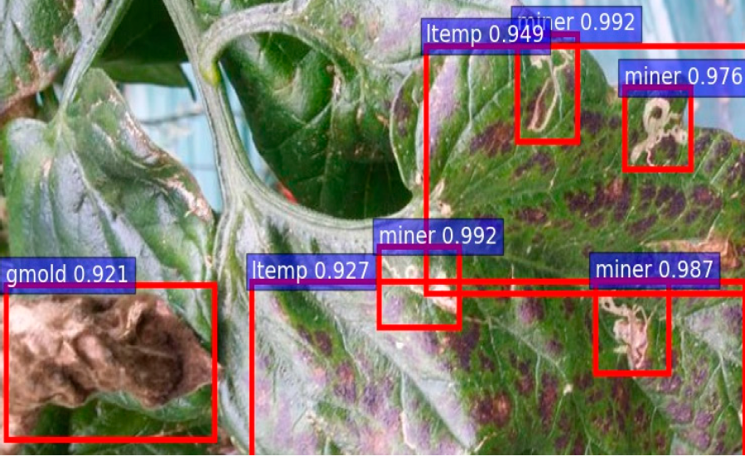
Applications – Multiple Diseases
Notes:
Tomato is the world’s second most cultivated vegetable
171 million tons of tomatoes are produced worldwild
This amount to 7 billions EURO of worldwide exportation of tomatoes
Susceptible to more than 200 diseases

Slide 16
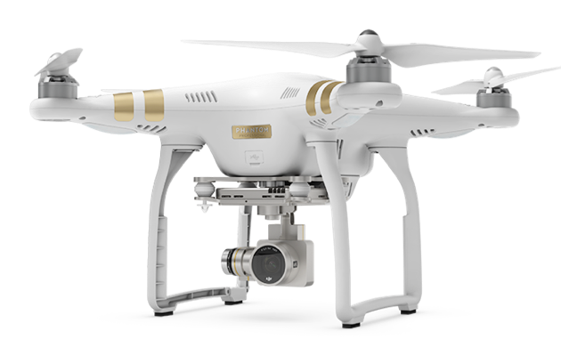
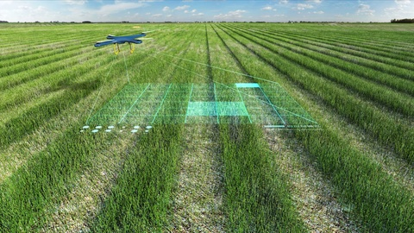

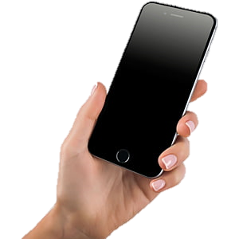
Advanced Features
Train the model using inputs from drones
Notes:
- Take inputs in form of images or videos from drones to gather more dataset to train the AI

Slide 17
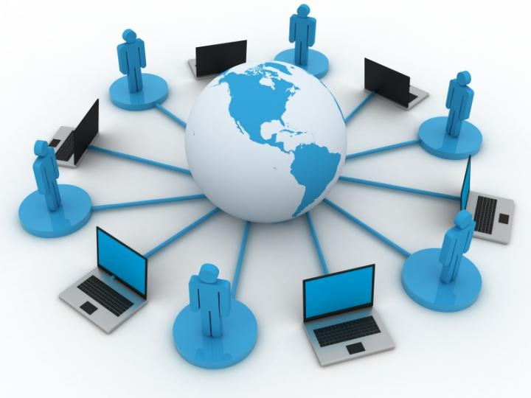
Advanced Features
A platform of images/videos of plants shared by all farmers.
Notes:
This will improve the sharing of data
As farmers will continuously used their drones, then more data will be collected
The AI will learn and be able to be more accurate with different sources of data

Slide 18
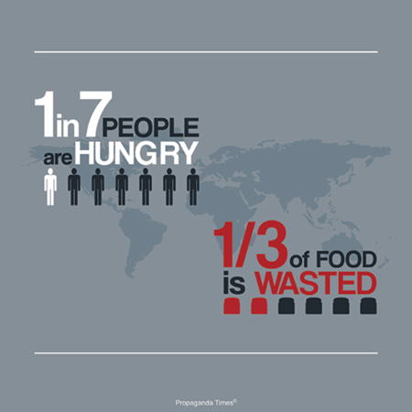
Relevance
450–500 million smallholder farmers worldwide
50% of hungry people live in those smallholder farms
Yield loss of more than 50%
Notes:
Smallholder farmers are more at risk:
High dependence on agriculture for their livelihoods
Chronic food insecurity
Remote location
Lack of access to safety nets
These 450–500 million smallholder farmers represent 85% of the farmers worldwide
Half of these farmers are situated in hungry countries
If we can help these farmers, then we can help reducing poverty & hunger worldwide
Yield loss of more than 50% due to pests & diseases

Slide 19
Q&A
Healthy Harvest Made Accessible!
Thank You!

